Slide 1

Database Design: Relational Model
Dr. Bijoy Bordoloi

Slide 2
Relational Database
A relational database is a database that is perceived by its users as a set of tables and nothing but tables

Slide 3
Relational Model
Tabular data structure - table, row, column, data type, null value
Eight operators - restrict, project, join, union, difference, intersect, product, divide
Integrity rules - primary and foreign keys, entity integrity, referential integrity
Three parts of relational model correspond to information, process, and integrity disciplines of software engineering

Slide 4
Data Structure
Table approximates the formal term relation and the physical file
Row approximates the formal term tuple and the physical record
Column approximates the formal term attribute and the physical field
Data type approximates the formal term domain

Slide 5
Characteristics 0f a Relation (Table)
The order of rows and columns immaterial.
All values are atomic – each row/column intersection represents a single value. In other words, ‘repeating groups’ are not allowed.
Every value in a column must be a member of a conceptual set of atomic values called a domain.
A value may be null, that is, not known or inapplicable
A relation, by definition, cannot have duplicate rows. Every table must have a ‘Primary Key’ which guarantees that there are no duplicate rows (discussed in depth later).

Slide 6
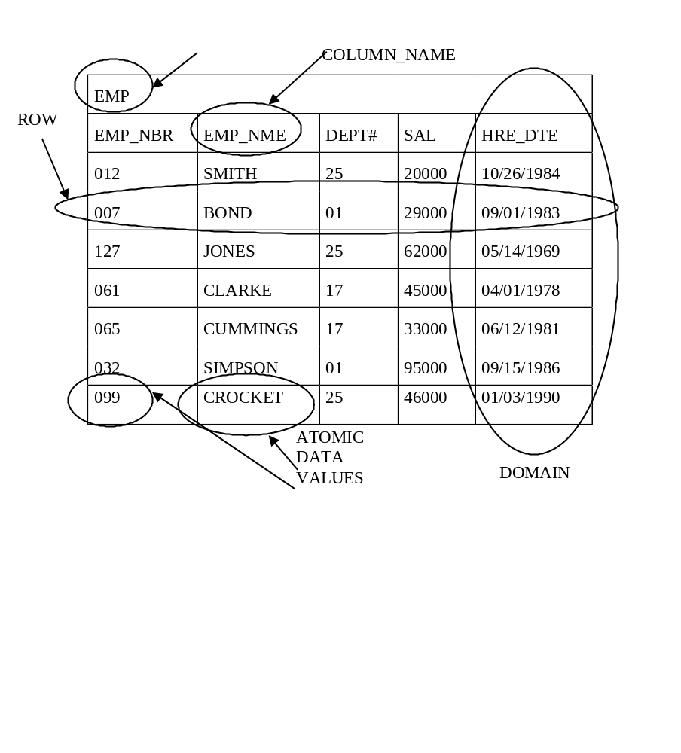
Data Structure
TABLE NAME

Slide 7
Example: Repeating Groups

Slide 8
Importance of Attribute Domain and Data Types
A relational DBMS can relate any data field in one table to any data field in another table as long as the two tables share a data field that is defined on the same ‘domain’ (the same data type).

Slide 9
Attribute Domain and Data Types
Consider the the following two tables, Student and Employee. Do these tables share any ‘common’ columns?
Student:
Employee:
SSN (Number (9)) | St_Name (Char (16))
SSN (Char (9)) | E_Name (Char (22)) | Phone (Number (10))

Slide 10
Semantic Data Types
(User Definable Data Types)
User-friendly data type names
User-friendly value sets
Composite data types

Slide 11
Semantic Data Types
CREATE DATATYPE ID [1 . . . 9999]
CREATE DATATYPE SOCSEC INTEGER
CREATE DATATYPE SEX [M, F]
CREATE DATATYPE GIVENNAME CHAR (12)
CREATE DATATYPE FAMILYNAME CHAR (25)
    CREATE DATATYPE FULLNAME (GIVENNAME,
GIVENNAME,
    FAMILYNAME)
CREATE TABLE EMPLOYEE (
EMP# ID
SOCSEC SOCSEC
NAME FULLNAME
SEX SEX
. . . )

Slide 12
Checking for Compatible Data Types
Operations combining different data types are disallowed in
general…
SELECT FNAME, LNAME
FROM EMPLOYEE
WHERE EMP# = SOCSEC
…however DBMS might automatically convert physical
dimensions…
…or user may define appropriate conversion procedures

Slide 13
Benefits of Semantic Data Types
Automatic validation of column values and checking for compatible data types reduces errors.
Data type names provide additional semantic information for users.
Productivity benefits of composite data types.

Slide 14
Null Values
Null – a special symbol, independent of data type, which means either unknown or inapplicable.
Result of comparison operators is null when either argument is null.
Result of arithmetic operators is null when either argument is null.

Slide 15
Examples of Operations on Nulls
Table: Compensation
EMP# JOBCODE SALARY COMMISSION
E10 SALES 12500 32090
E11 NULL 25000 8000
E12 SALES 44000 0
E13 SALES 44000 NULL
E14 PROG 19500 NULL
E15 CLERK NULL NULL

Slide 16
Examples of Operations on Nulls
What is the output of the following query?
SELECT EMP#
FROM COMPENSATION
WHERE JOBCODE = “SALES”
AND (SALARY + COMMISSION) > 30000

Slide 17
Table Definition in SQL (DB2)
CREATE TABLE EMPLOYEE (
EMP# SMALLINT NOT NULL,
SOCSEC INTEGER,
FNAME VARCHAR (12) NOT NULL,
LNAME VARCHAR (25) NOT NULL,
SEX CHAR (1),
SPOUSE SMALLINT,
SALARY FLOAT,
JOBCODE VARCHAR (6),
DIVNAME VARCHAR (12) NOT NULL,
DEPT# SMALLINT NOT NULL
)
  Each column has a name that is unique within the table and is specified to store a specific type of data including whether NULL values are allowed or not.

Slide 18
Oracle: NOT NULL Constraint
A NOT NULL constraint means that a data row must have a value for the column specified as NOT NULL.
A fairly standard practice is to assign each constraint a unique constraint name.
In Oracle, if constraints are not named, then Oracle assigns meaningless system-generated names to each constraint.

Slide 19
Oracle Example: Not Null Constraint
fname VARCHAR2(15)
CONSTRAINT nn_emp_last_name NOT NULL,
lname VARCHAR2(25)
CONSTRAINT nn_emp_first_name NOT NULL,

Slide 20
Characteristics 0f a Relation (Table)
The order of rows and columns immaterial.
All values are atomic – each row/column intersection represents a single value. In other words, ‘repeating groups’ are not allowed.
Every value in a column must be a member of a conceptual set of atomic values called a domain.
A value may be null, that is, not known or inapplicable
A relation, by definition, cannot have duplicate rows. Every table must have a ‘Primary Key’ which guarantees that there are no duplicate rows (discussed in depth later).

Slide 21
KEYS
Relational DBMS uses associative addressing.
  Identify and locate rows by value
  Physical address is transparent to user

Slide 22
KEYS
A
B
C
C
X
Y
C
Z
ASSOCIATIVE ADDRESSING
A
B
C
*
*
X
Y
*
Z
*
PHYSICAL ADDRESSING

Slide 23
KEYS
Associative addressing is simpler for the end-user.
Physical data independence – storage structures and access paths are transparent to user and application programs

Slide 24
KEYS
Associative addressing is based on keys – a column, or group of columns, used to identify rows.
Simple key – a key formed from a single column
Composite key – a key formed from several columns
The relational model has five kinds of keys
    Super
    Candidate
    Primary
    Alternate (secondary)
    Foreign

Slide 25
KEYS
In relational DBMS, a key is not the same as an index!
Keys identify rows (logical design)
Indexes locate rows (physical design)

Slide 26
Candidate Keys
Candidate Key – any (simple or composite) column of a table which is both unique and minimal.
Uniqueness – no two rows in a table may have same candidate key value at any time.
Minimality – every column of a composite candidate key must be necessary for uniqueness.

Slide 27
Primary Key
Primary Key – a candidate key chosen by the database designer to identify rows of a table in queries
The primary key is the only guaranteed way to identify rows in queries
UPDATE COMPENSATION
SET SALARY = 30000
WHERE EMP# = E3
Primary keys must be unique, minimal, non-null, and preferably time-invariant.
Alternate key – any candidate key which is not a primary key – may have null values.

Slide 28
Candidate Keys/Primary Key
EMPLOYEE
EMP-ID SS-NUM EMP- NAME PHONE
Assume every employee has a phone#, only one phone# , and must have a phone# and that no two employees share the same phone#.
What is(are) the Candiadate Key(s)?
What would you choose as the Primary Key of table EMPLOYEE?

Slide 29
Primary Key
The Primary Key MUST of course be a Determinant
- i.e., all the other non-key attributes of a table must be functionally dependent on the primary key.
In other words, for any given value of the primary key, one should get one and only value of the one non-key attributes

Slide 30
Functional Dependency
Example
  SOC_SEC_NBR EMP_NME
SOC_SEC_NBR
EMP_NME
One and only one EMP_NME for a specific SOC_SEC_NBR
SOC_SEC_NBR is the determinant of EMP_NME
EMP_NME is functionally dependent on SOC_SEC_NBR

Slide 31
Determinants and Keys
What is (are) the determinant (s)?
What is (are) the candidate key (s)?
What is the primary key?
Table: Student-Dorm-Fee
SID | DORM | FEE
101 | Oracle | 1000
102 | Oracle | 1000
103 | DB2 | 800
104 | DB2 | 800
105 | Sybase | 500

Slide 32
Primary Key
EMPLOYEE
EMP-ID SS-NUM EMP- NAME PHONE
Assume every employee must have a phone# , can have more than one phone #, and more than one employee share the same phone#.
What is the Primary Key?

Slide 33
Primary Key
EMPLOYEE
EMP-ID SS-NUM EMP- NAME PHONE
Assume every employee must have a phone# , can have more than one phone #, but no two employees can share the same phone#.
What is the Primary Key?

Slide 34
Entity Integrity
Entity Integrity – If the primary key (PK) is a composite key then all columns of the primary key must be non-null.
The primary key is the only guaranteed way to positively identify rows in queries

Slide 35
Questions
What similarities and differences do you find between an Entity and a Table?

Slide 36
Foreign Keys
Foreign key – a (simple or composite) column which refers to the primary key of some table in a database.
Foreign and primary keys must be defined on same data type.
A foreign key may be contained in a primary key or another foreign key.

Slide 37
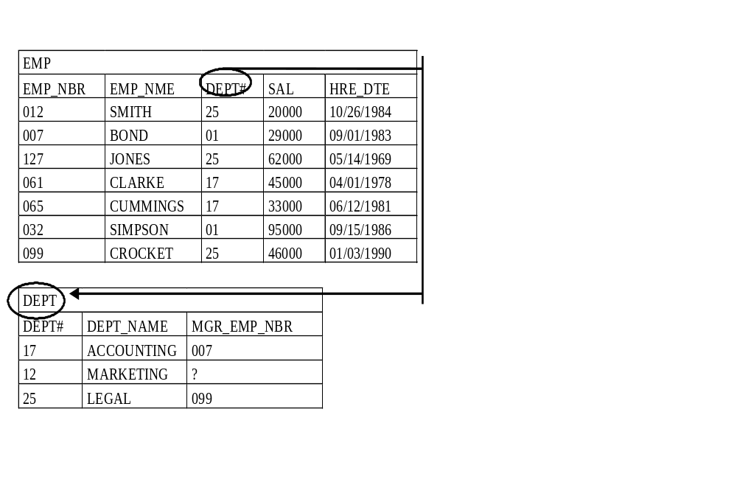
Foreign Keys Defined
A foreign key
is a column or
columns in a table
that matches a primary
key in some table
in the database.
Are there any
other foreign keys?

Slide 38
In-Class Exercise
To be handed out in class

Slide 39
Referential Integrity
Referential Integrity – a foreign key which identifies primary key of table T must either be wholly null or match the value of the primary key of some row in T

Slide 40
Rationale for Referential Integrity
Any non-primary key column may be unknown or inapplicable (wholly null).
An unmatched non-null foreign key identifies a non-existent object and is in error

Slide 41
Referential Integrity Rules (Foreign Key Rules)
How is referential integrity maintained in a database?
Some operations that may cause a violation …
  Insert of PK values – no problem
  Update of PK values – what happens to matching foreign keys?
  Delete of PK values – what happens to matching foreign keys?
  Insert of FK values – disallowed unless matching primary key exists
  Update of FK values – disallowed unless matching primary key exists
  Delete of FK values (FK Values set to NULL) – no problem as long as NULL values are allowed in the FK

Slide 42
Referential Integrity Rules
So, for each FK in each table the database designer must specify:
Whether or not NULLs allowed in the FK
What should happen to the FK values should the related PK values in the PK table are deleted or updated

Slide 43
Null Rule Alternatives
Nulls allowed in foreign key columns (minimum cardinality 0)
Nulls disallowed in foreign key columns (minimum cardinality 1)

Slide 44
Delete Rule Alternatives
Delete of primary key cascades to foreign keys
Delete of primary key nullifies foreign keys
Delete of primary key is restricted if there are any matching foreign keys

Slide 45
Update Rule Alternatives
Update of primary key cascades to foreign keys
Update of primary key nullifies foreign keys
Update of primary key is restricted if there are any matching foreign keys

Slide 46
Rule Alternatives: Meaning
(Oracle Syntax)
On Delete/Update Cascade:
Any delete/update made to the PK table should be cascaded through to the FK table.
NOTE:
If a PK value is deleted in the PK table then all the rows in the FK table with matching FK values are also deleted in entirety.

Slide 47
Rule Alternatives: Meaning
(Oracle Syntax)
On Delete/Update Set Null:
Any PK values that are deleted/updated in the PK table, cause affected FK values in the FK table to be set to null.
Unlike Delete Cascade, the entire row is not deleted, only the affected FK values are set to null.

Slide 48
Rule Alternatives: Meaning
On Delete/Update Restrict:
Any updates made to the PK table that would delete or change a primary key value will be rejected unless no foreign key references that value in the FK table(s).
In other words, you are restricted to deleting or updating only those PK values in the PK table which do NOT appear as FK values.
Example:

Slide 49
Referential Integrity : Examples
  What might be the appropriate referential integrity rules for the tables Employee, Division and Department?

Slide 50
Documentation
Database designer specifies
  Primary keys
  Alternate keys
  Foreign keys
  Foreign key rules, for each foreign key
  Semantic data types
  Default values (optional)

Slide 51
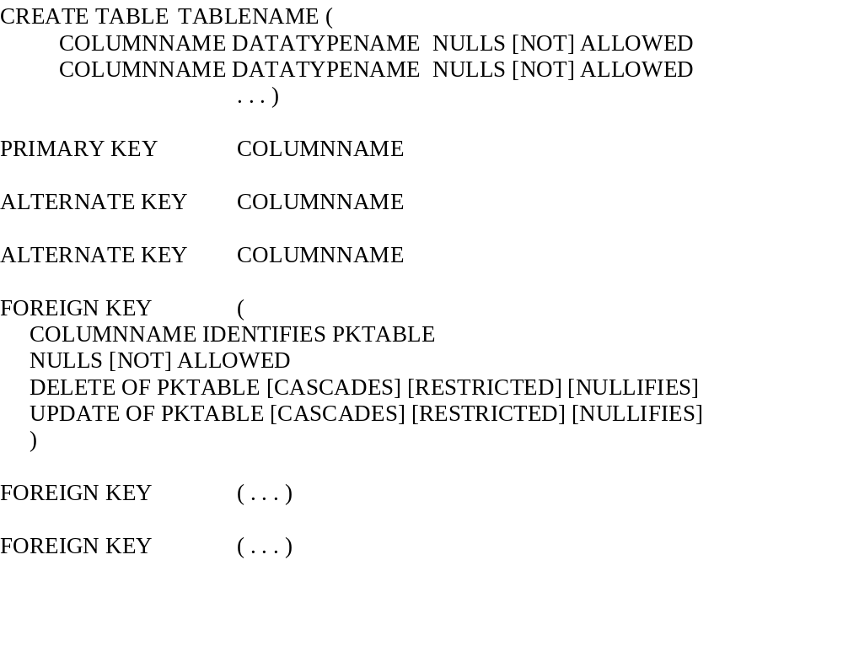
Enhanced SQL

Slide 52
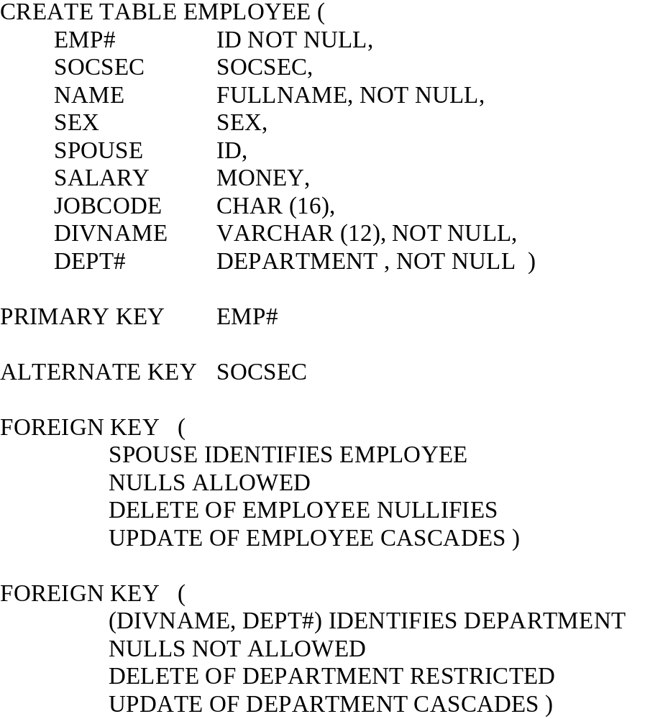
Example (DB2)

Slide 53
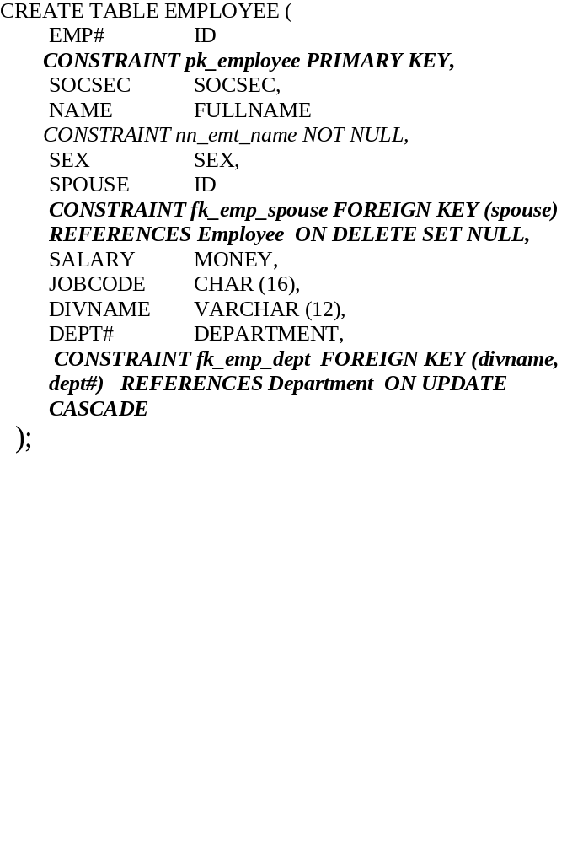
Example (Oracle)

Slide 54
IN-Class Exercise
Distributed in class

